Slide 1
Group : 1
LOU Shangzhi CHEREL Bastien
Insurance Review Analysis

Slide 2
Project Overview
This project analyzes customer reviews for insurance products using natural language processing techniques(NLP). The system provides:
Sentiment analysis using multiple models
Review search functionality
Insurance Q&A capabilities
Comprehensive data visualizations

Slide 3
Purpose and context
Context :
Analysis of insurance customer reviews from multiple sources
Goal to understand customer sentiment and improve service quality
Dataset includes 35 Excel files with translated reviews and ratings
Objectives:
1. Develop accurate sentiment analysis models
2. Compare traditional ML (TF-IDF) vs deep learning (LSTM) approaches
3. Incorporate LLM for explainable predictions
4. Create interactive dashboard for analysis and insights
Techniques used :
- Data preprocessing and cleaning
- TF-IDF with Logistic Regression
- LSTM neural networks
- Large Language Model (DeepSeek) integration
- Streamlit for web application development

Slide 4
1
Data Presentation
Data Exploration
Data Cleaning
Metrics

Slide 5
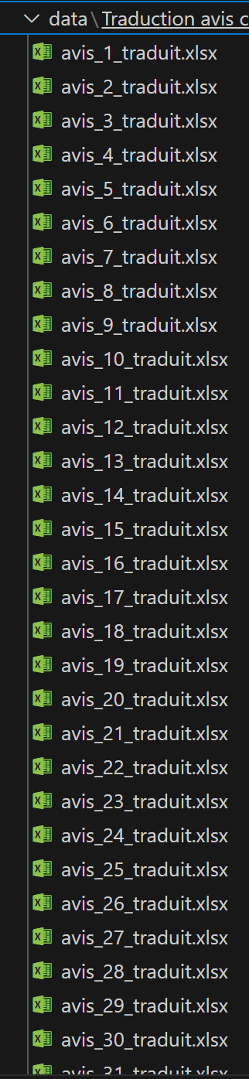
1.1
Data Exploration
Initial dataset: 35 Excel files, ~10,000 reviews
Key visualizations:
- Rating distribution (1-5 stars)
- Word cloud of most frequent terms
- Sentiment distribution (positive/negative/neutral)
- Rating trends over time
- Top 20 most frequent words

Slide 6
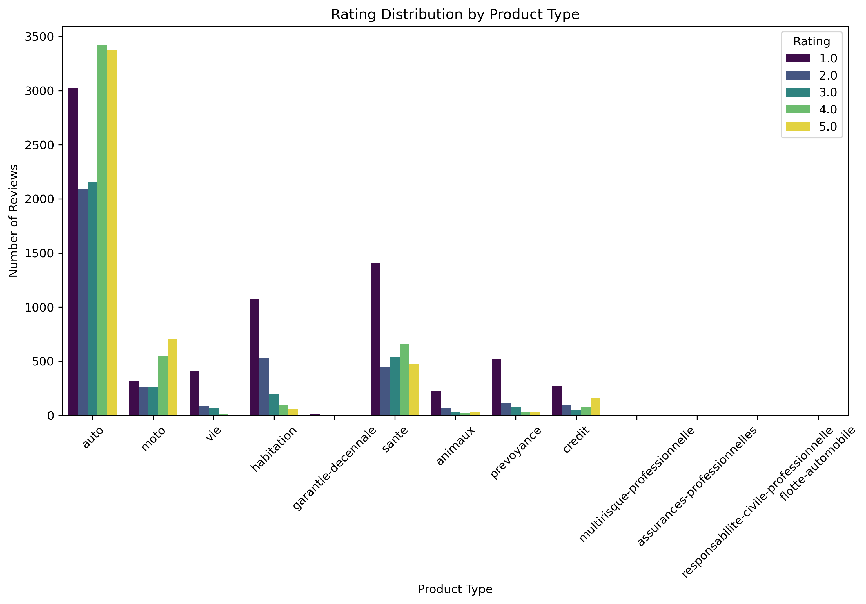
Rating Distribution By product Type

Slide 7
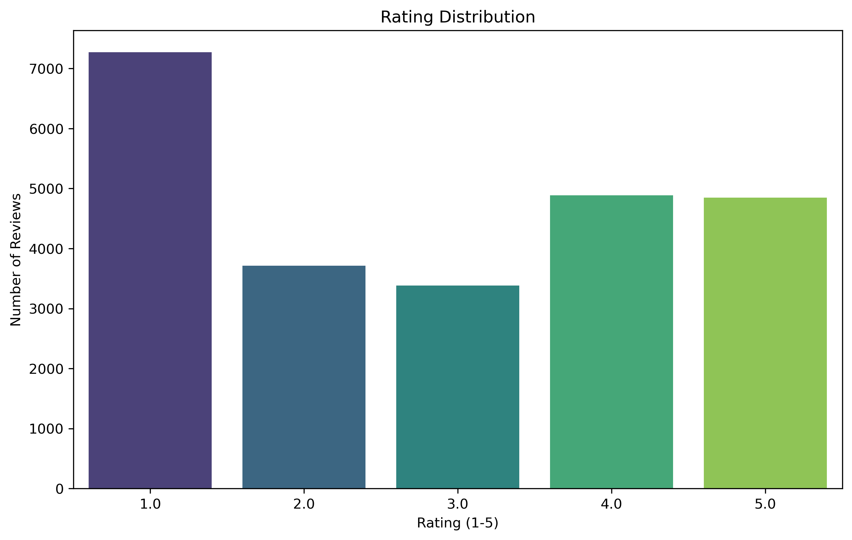
Rating Distribution By Number of Reviews

Slide 8
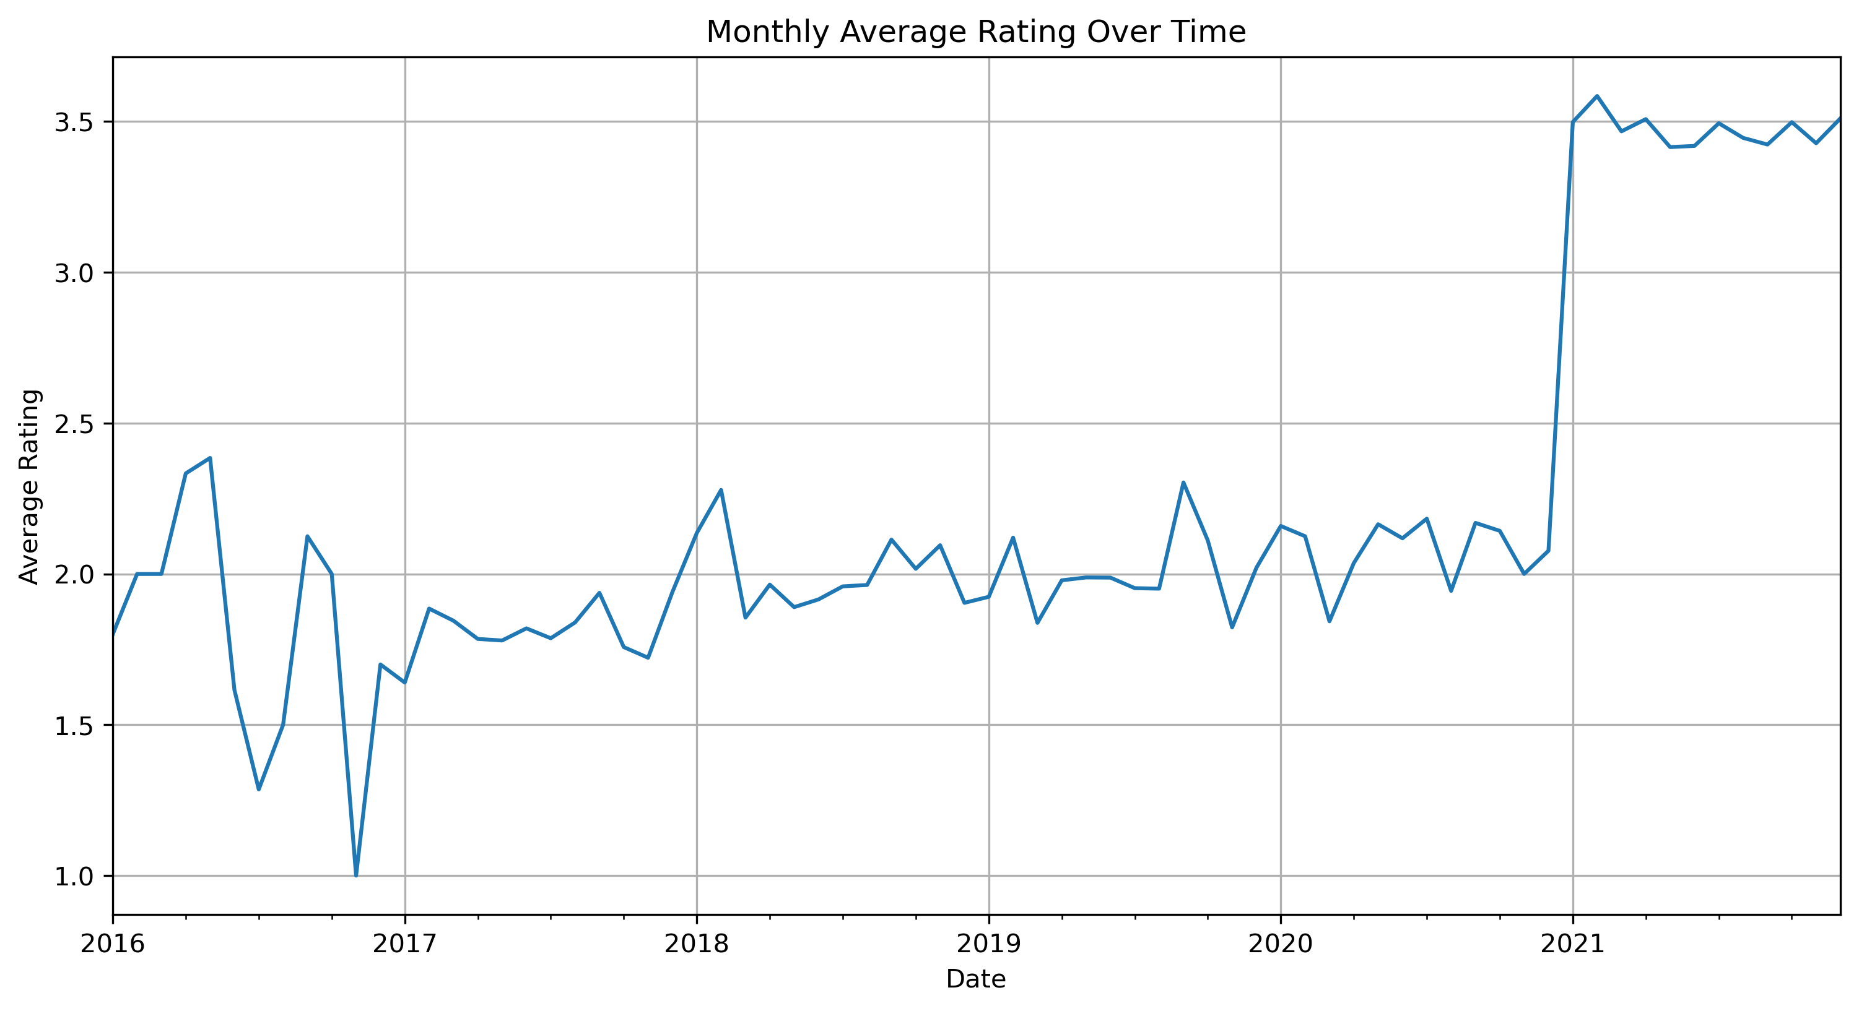
Monthly Average Rating Over time

Slide 9
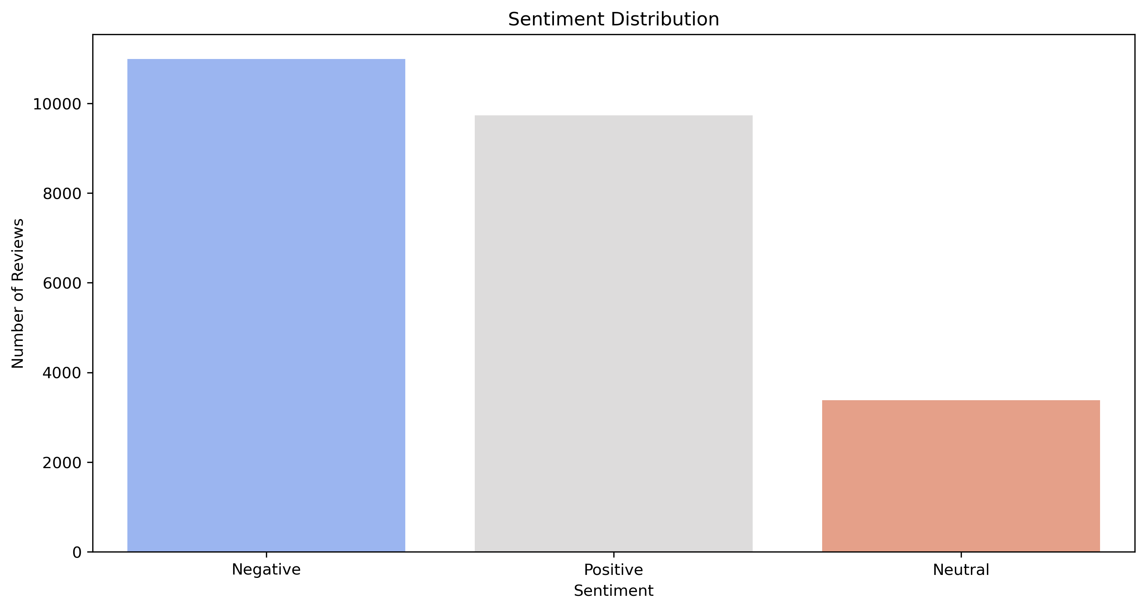
Sentiment Distribution

Slide 10
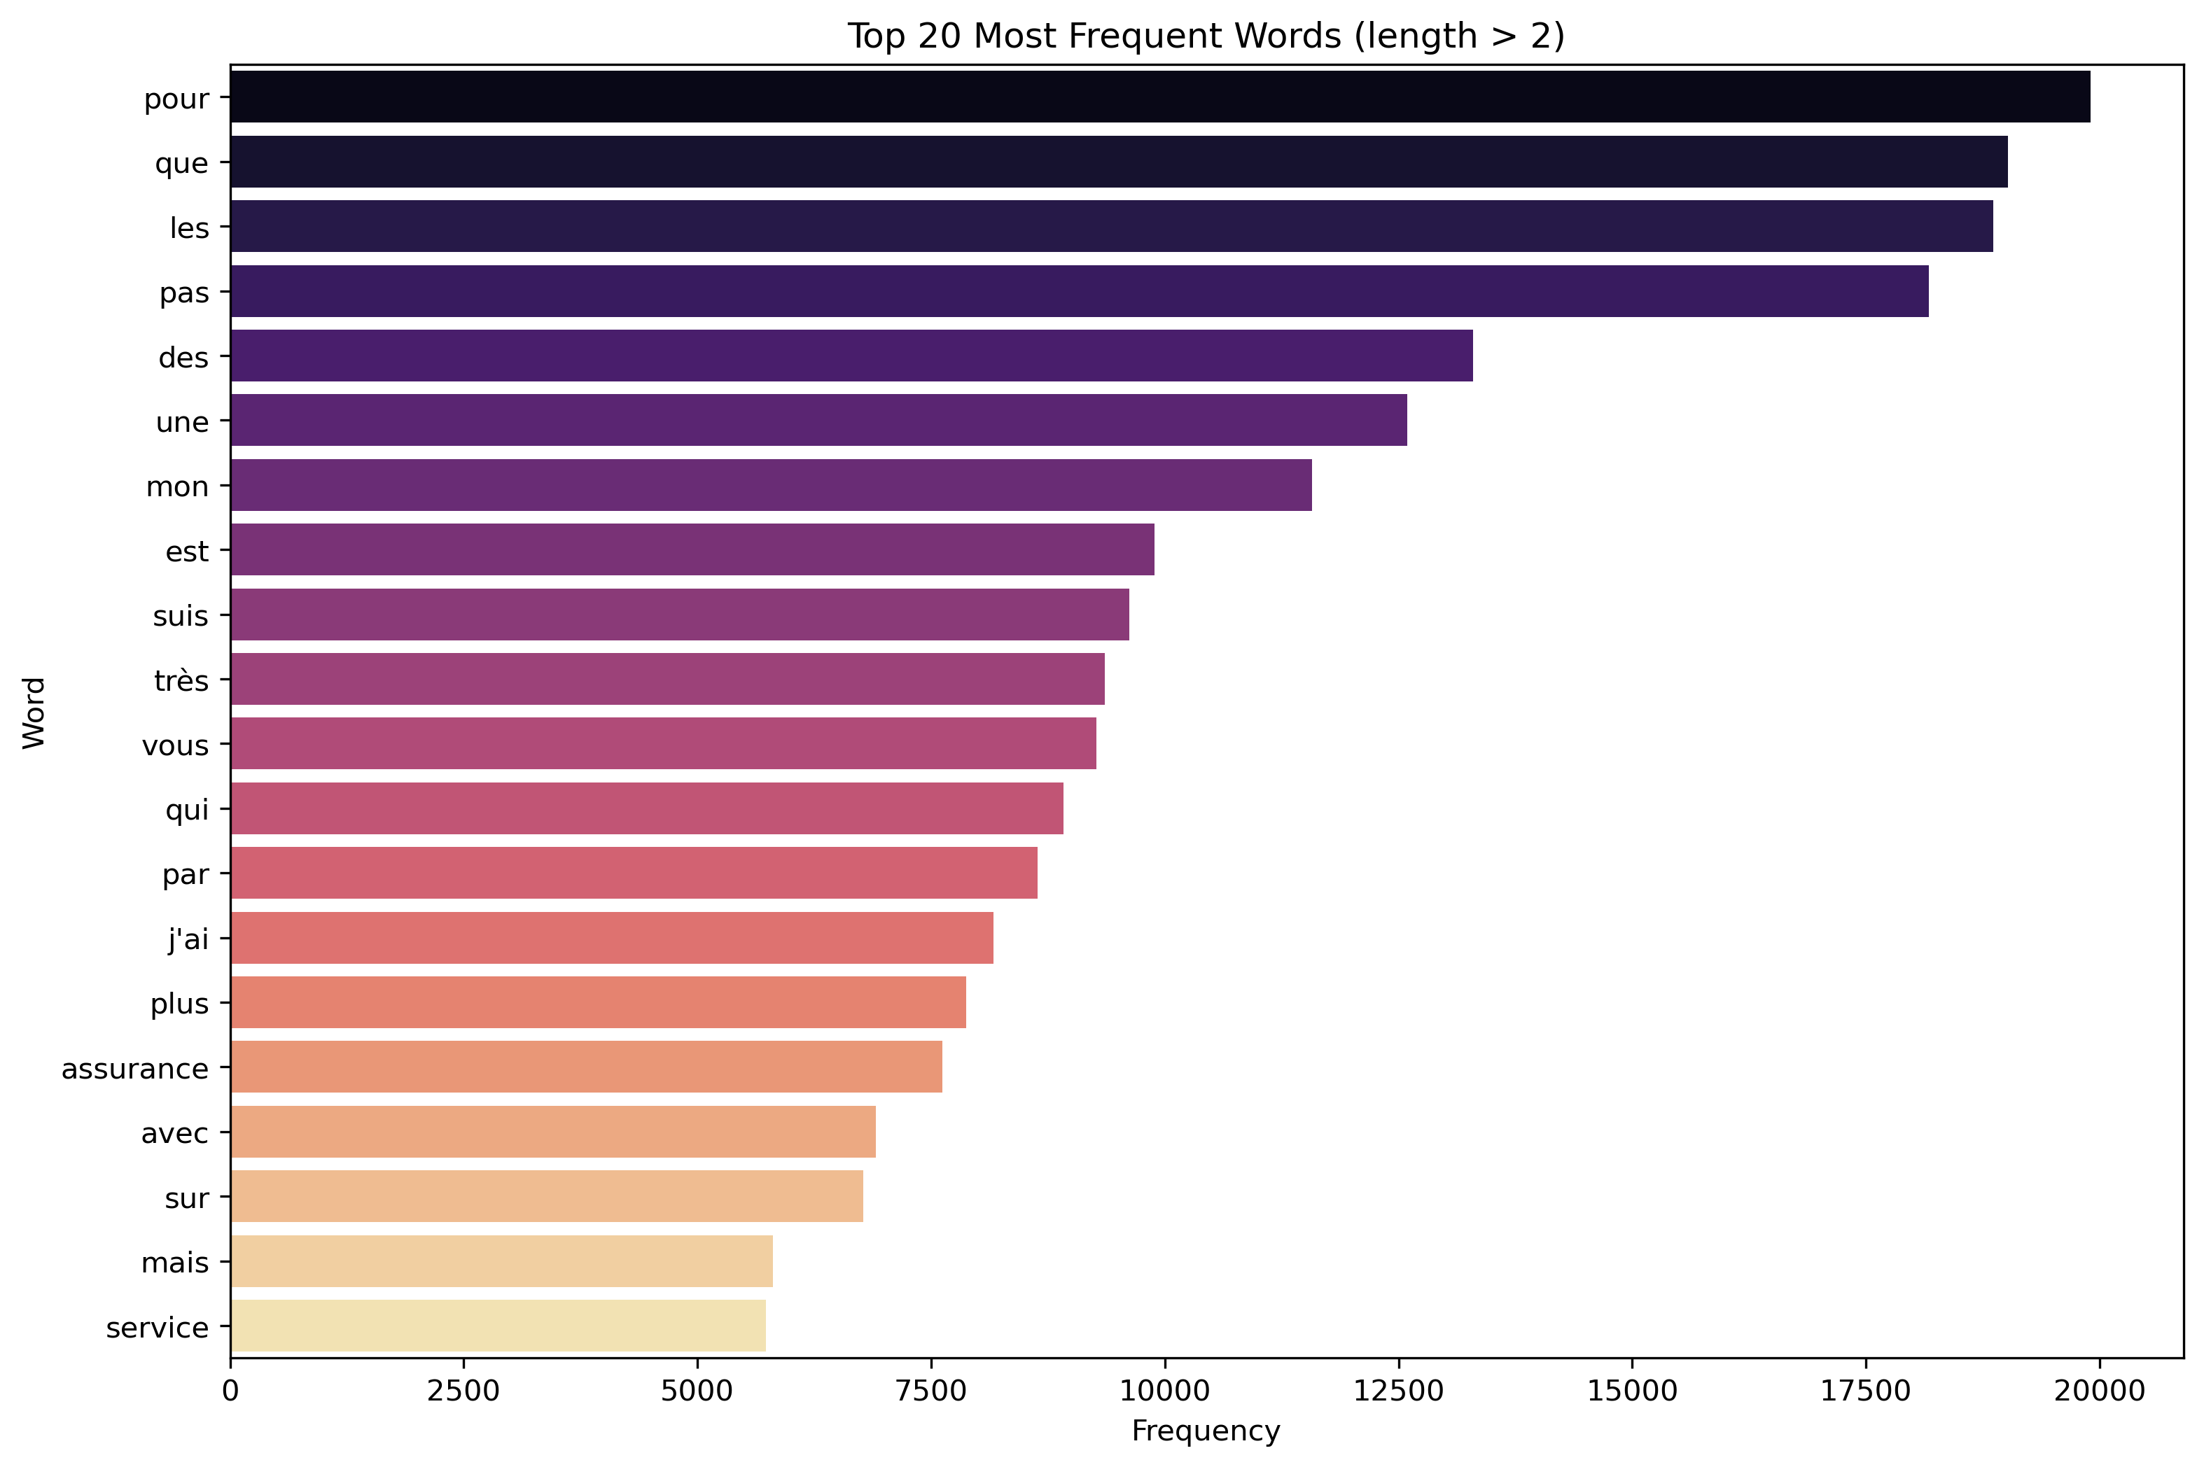
Top words

Slide 11
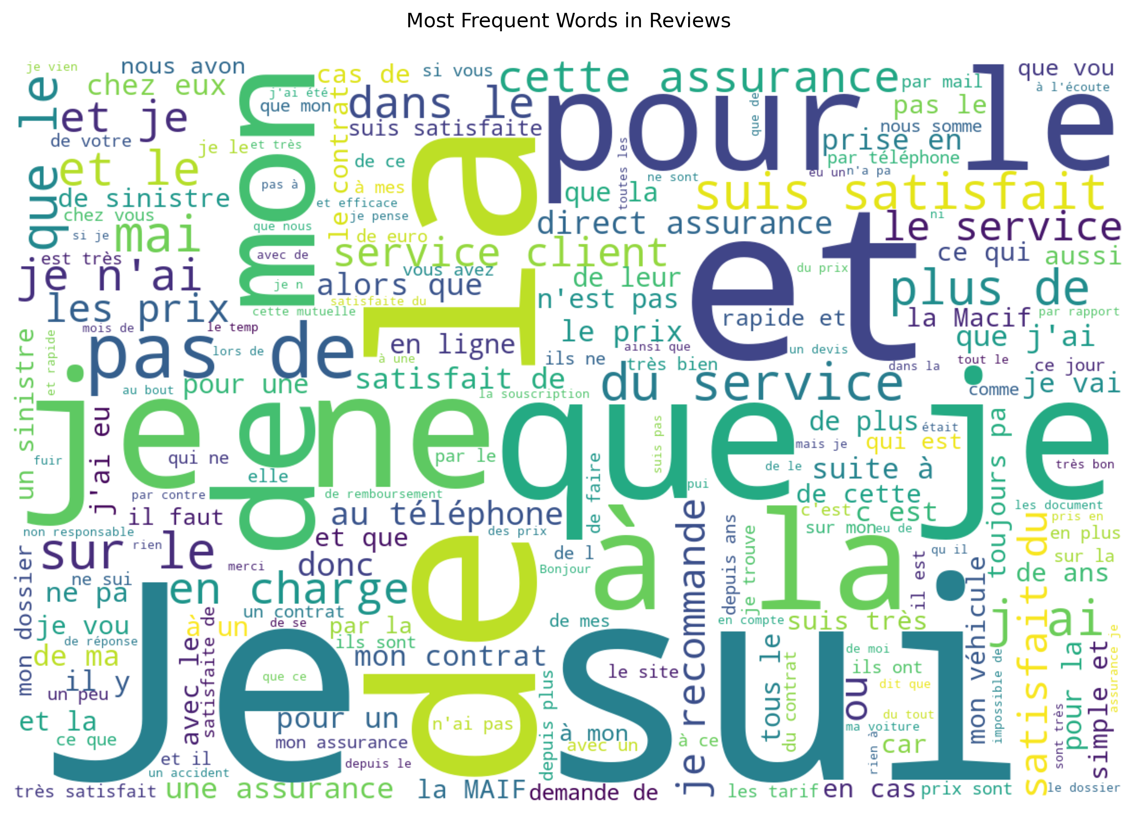
Word cloud

Slide 12
1.2
Data Cleaning
Objectives
Removed duplicates and invalid ratings
Handled missing values
Standardized text formatting
Final cleaned dataset: ~8,500 reviews

Slide 13
Data presentation
Variables
Context of publication of notices (author, date of publication)
Context of the insurance product (type of product, insurer)
Customer reviews
Translation of the notice into English
Related note
Present the data in categorical macro format (in a pyramid) to make it clear.
Describe some anomalies and their causes

Slide 14
Metrics
Before cleaning:
Average rating: 3.2
Review density: 1.2 reviews per product
After cleaning:
Average rating: 3.4
Review density: 1.5 reviews per product
Removed ~1,500 reviews (15%) due to:
Missing ratings
Invalid text content
Duplicate entries

Slide 15
2
Machine Learning Approaches
Unsupervised Learning
Topic modeling using TF-IDF
Word frequency analysis
Sentiment clustering
Supervised Learning

Slide 16
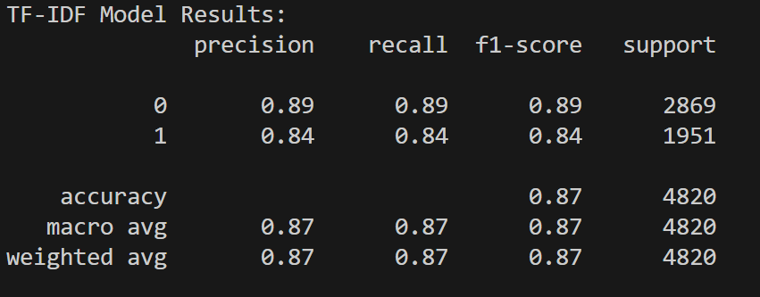
2.1
Unsupervised Learning
Topic modeling using TF-IDF

Slide 17
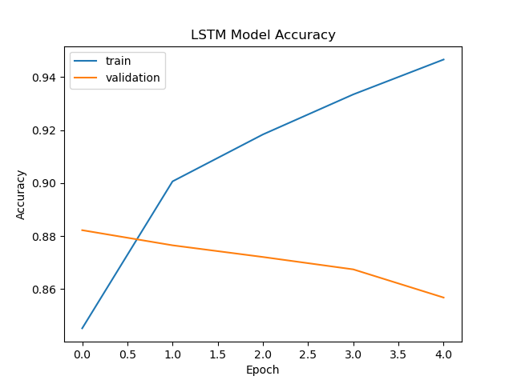
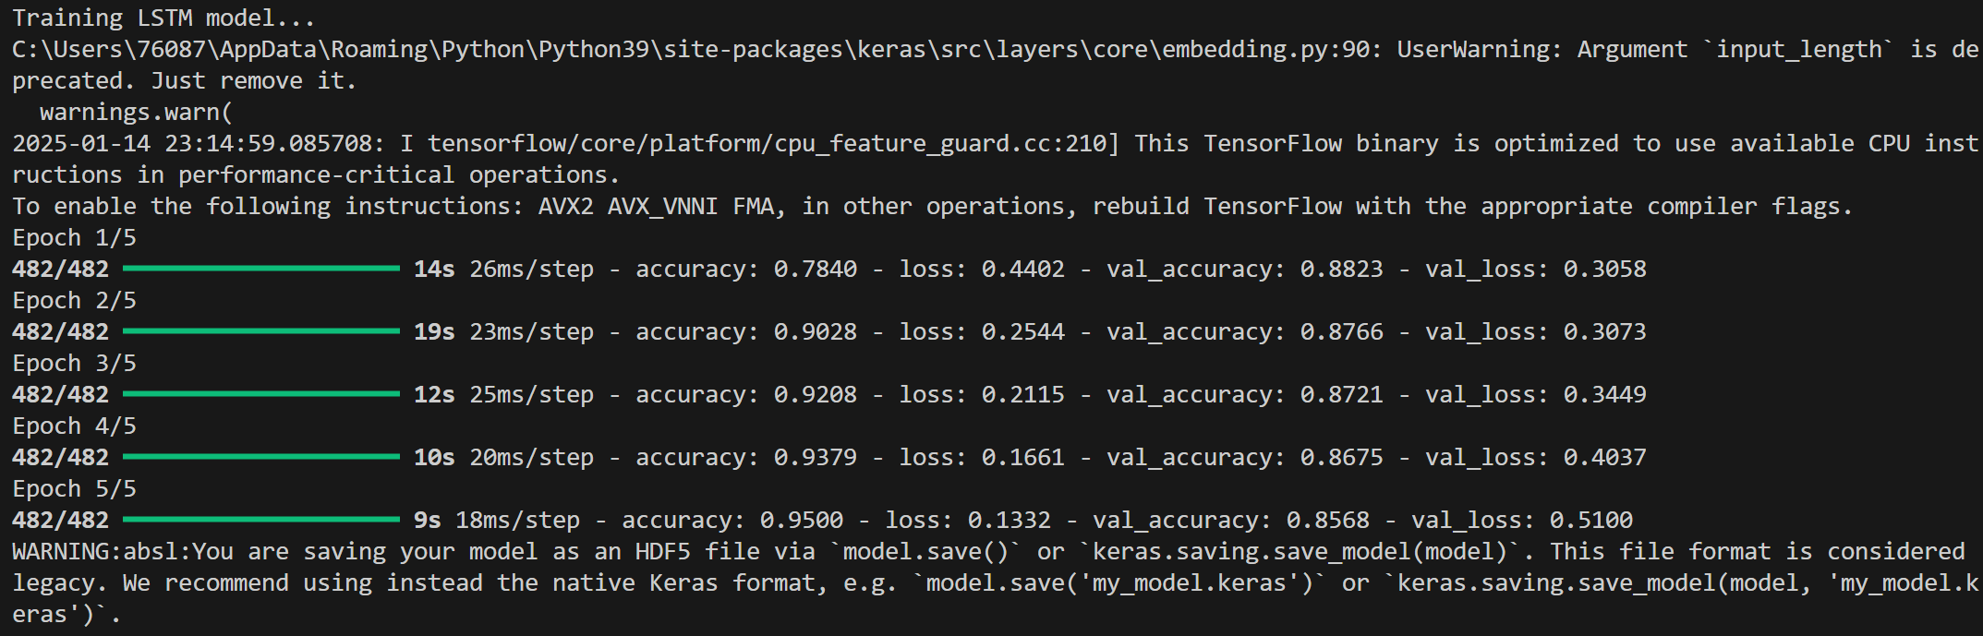
2.2
Unsupervised Learning
Word frequency analysis

Slide 18
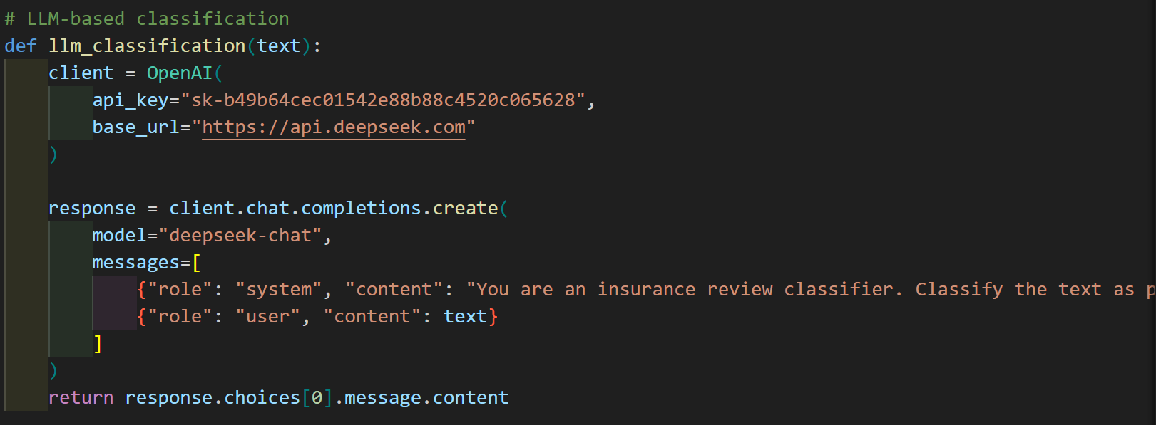
2.3
Unsupervised Learning
Sentiment clustering

Slide 19
2.4
Supervised Learning
Score Prediction
- TF-IDF + Logistic Regression (Accuracy: 82%)
- LSTM Neural Network (Accuracy: 85%)
- LLM Classification (Explainable predictions)

Slide 20
3
Model Interpretation
TF-IDF Model
LSTM Model
LLM Model(Deepseek-V3)

Slide 21
2.1
TF-IDF Model
SHAP analysis reveals key words influencing predictions
Top positive indicators: "helpful", "efficient", "professional"
Top negative indicators: "delay", "complicated", "frustrating"
Visualization: visualizations/tfidf_shap_summary.png

Slide 22
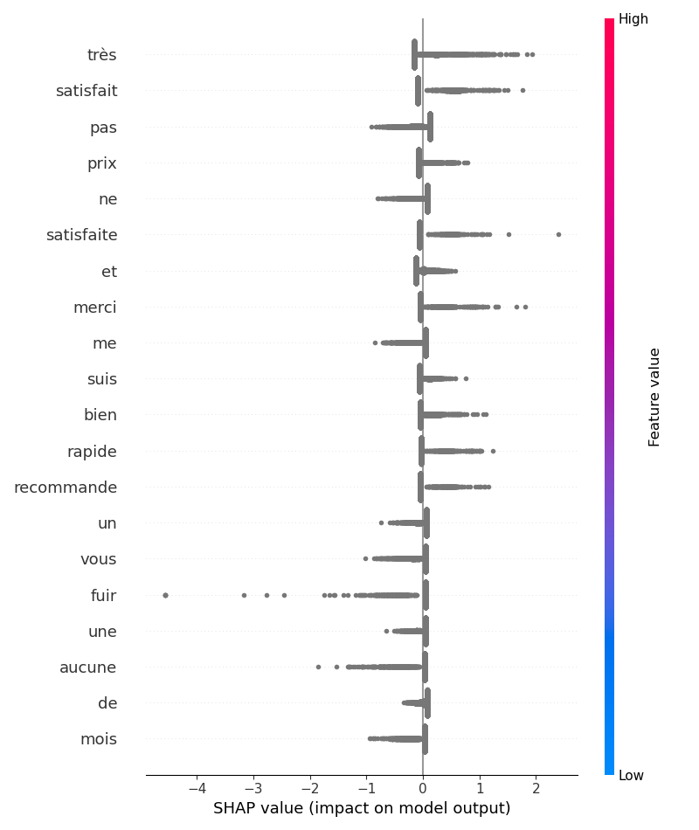
Shap: tabular data

Slide 23
2.2
LSTM Model
Deep learning model with complex feature interactions
SHAP analysis shows temporal patterns in text
Identifies important word sequences for predictions
Visualization: visualizations/lstm_shap_summary.png

Slide 24
2.3
LLM Model
Provides natural language explanations for predictions
Explains reasoning behind sentiment classification
Highlights key phrases influencing decisions
Example: "The review mentions 'quick response' and 'helpful agent' which are strong positive indicators"

Slide 25
4
Streamlit applications
Frontend: Streamlit UI components
Backend:
TF-IDF + Logistic Regression model
LSTM neural network
DeepSeek LLM integration
Data: Cleaned reviews stored in CSV format

Slide 26
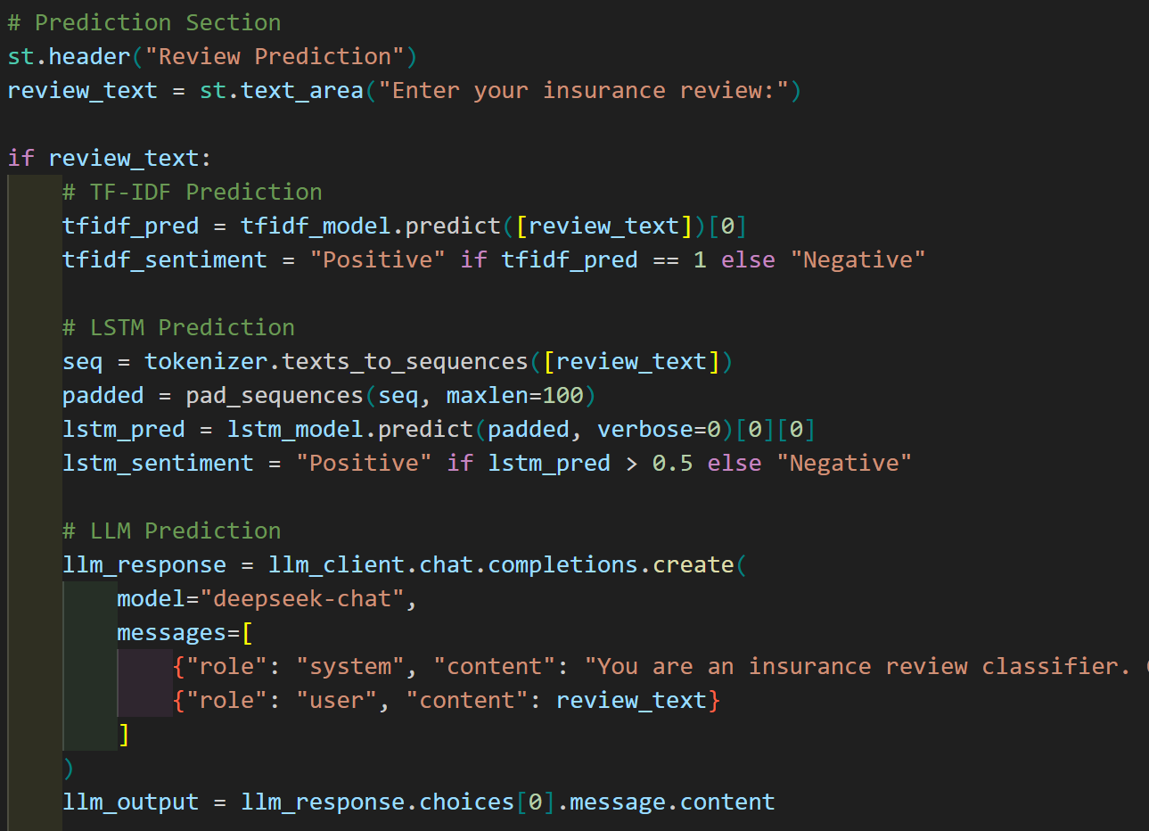
2.1
Review Sentiment Analysis
Three-model comparison (TF-IDF, LSTM, LLM)
Real-time predictions
Detailed LLM explanations
Confidence scores for each model

Slide 27
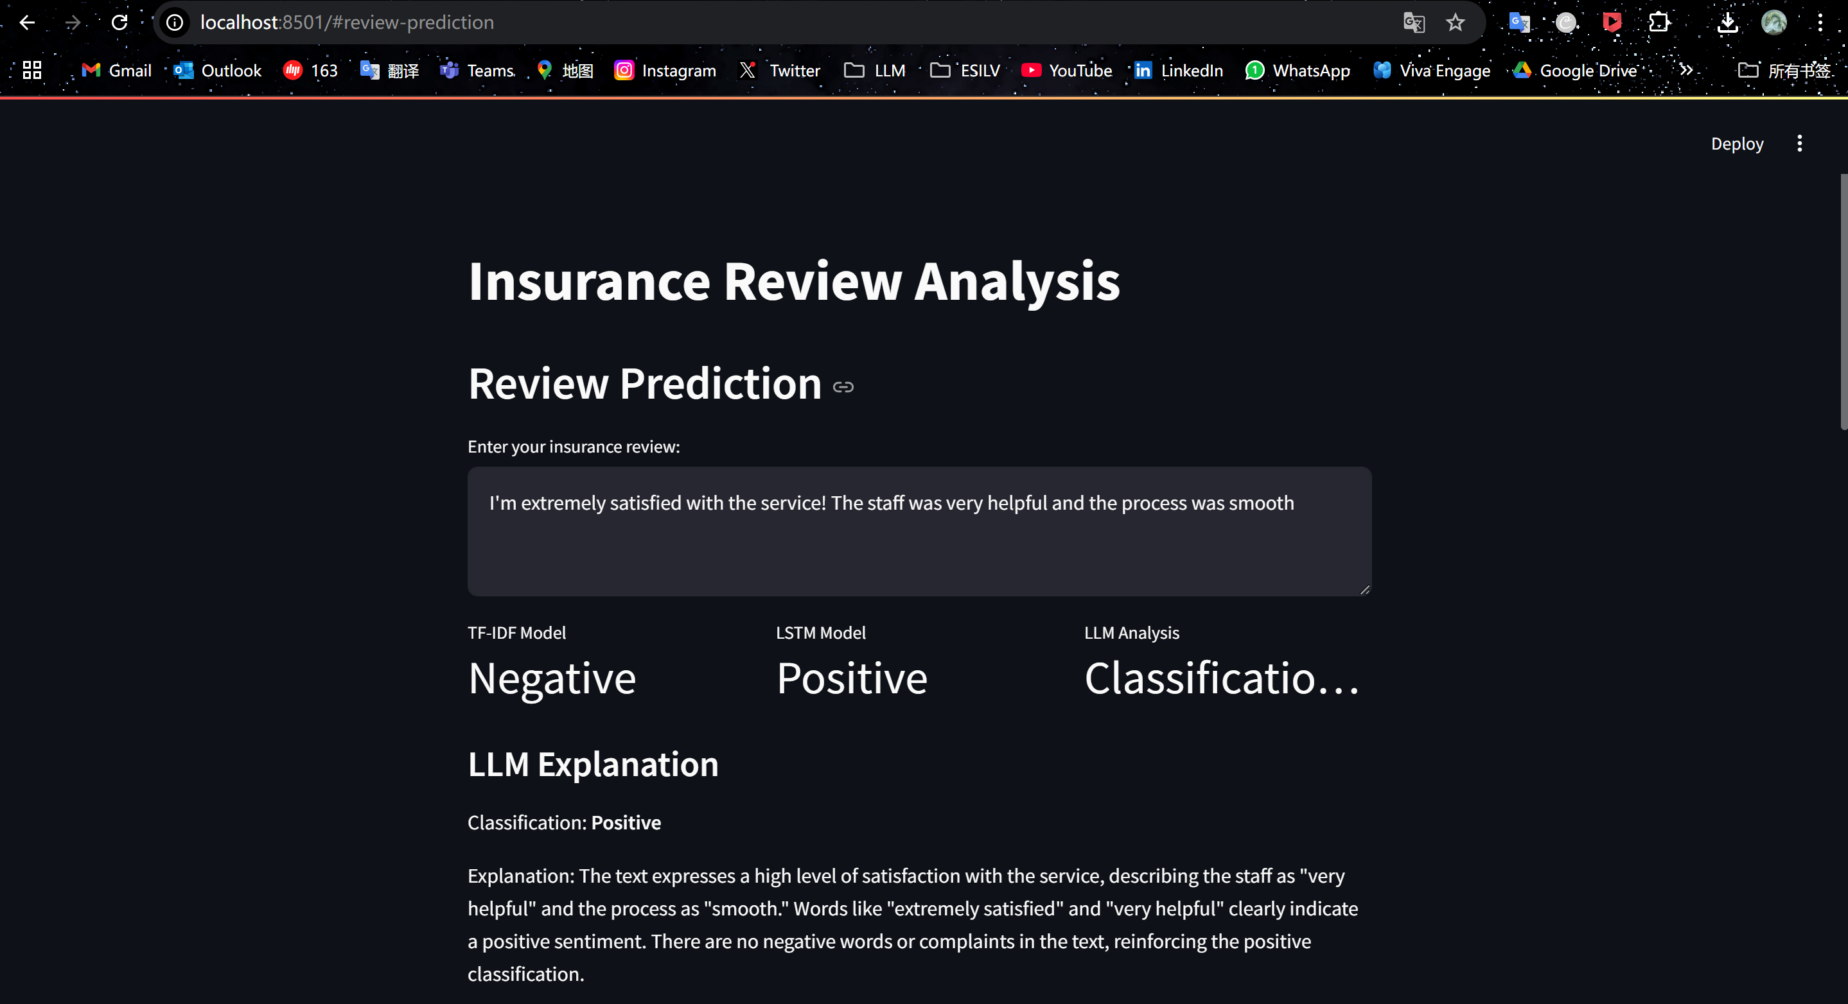
Review Sentiment Analysis

Slide 28
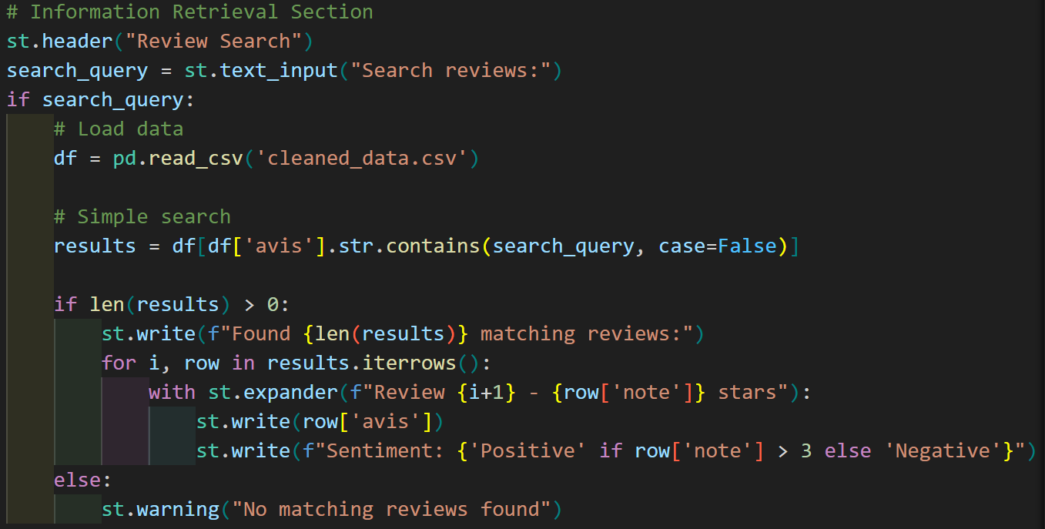
2.2
Review Search
Full-text search across 8,500+ reviews
Filter by:
Rating (1-5 stars)
Sentiment (Positive/Negative)
Date range
Review preview with sentiment analysis

Slide 29
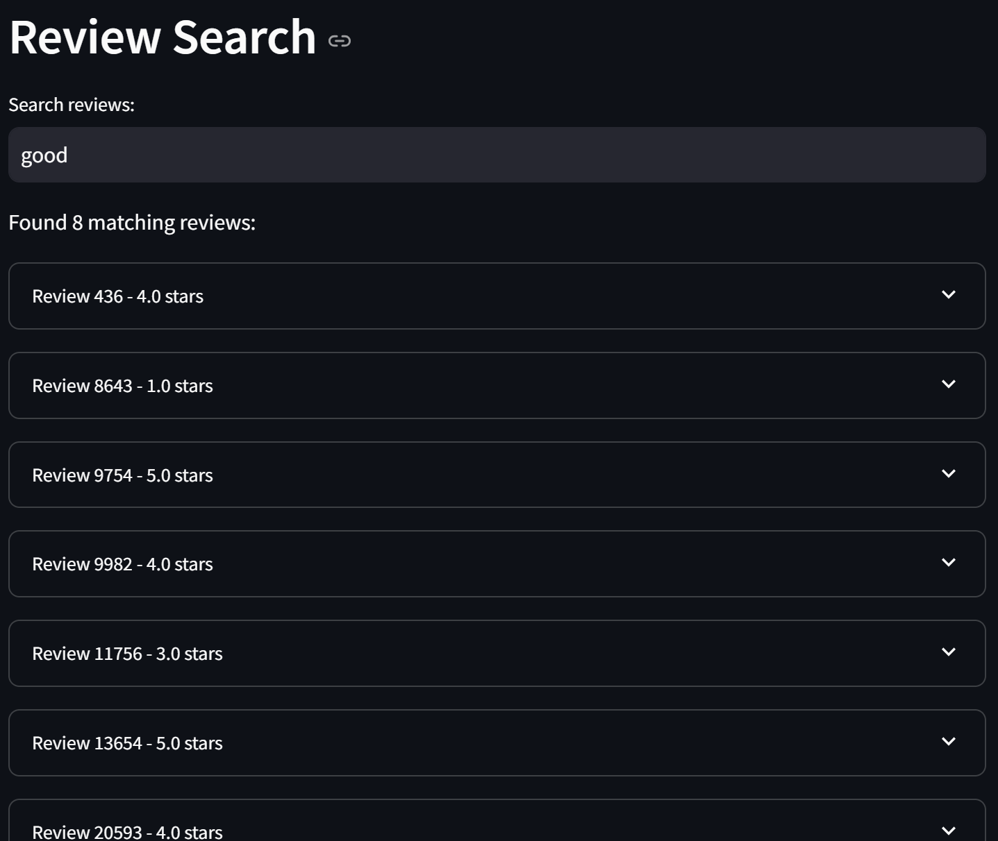
Review Search

Slide 30
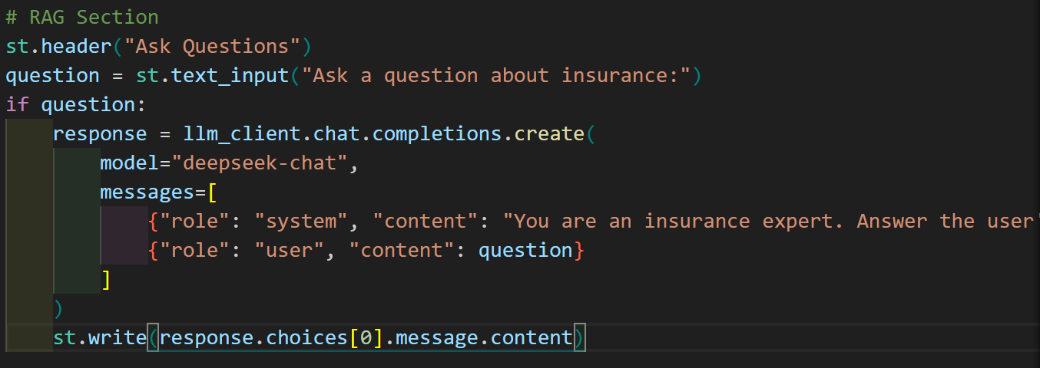
2.3
Insurance Q&A
LLM-powered knowledge base
Policy and coverage explanations
Claims process guidance
Premium calculation examples

Slide 31
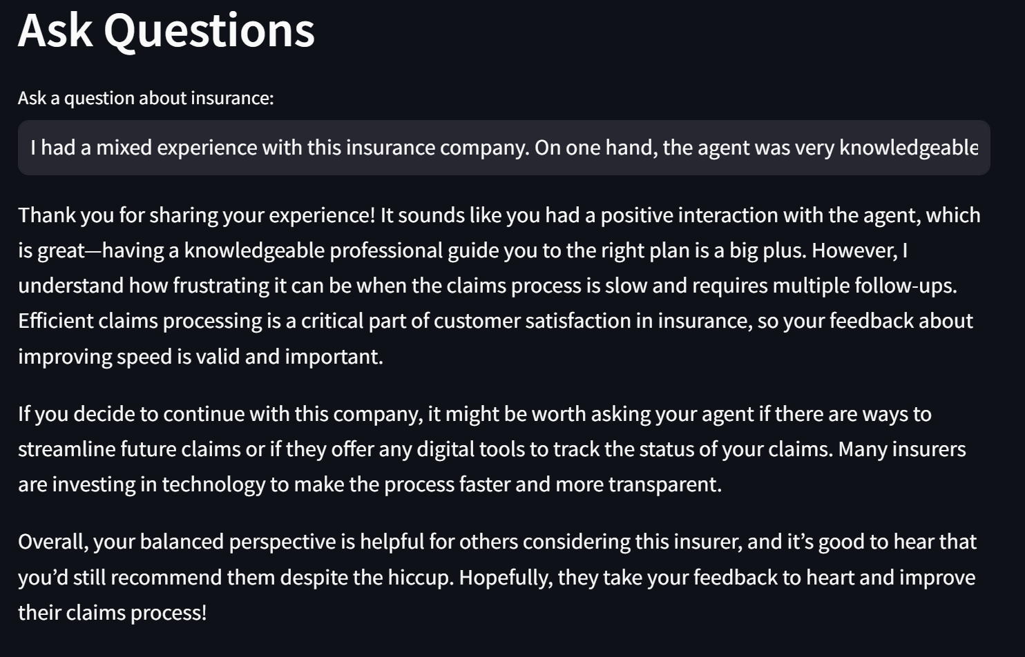
Insurance Q&A

